Slide 1

Weakly-supervised person name transliteration trained on Twitter data

Slide 2
Introduction to Machine Transliteration
What is it?
Transliteration is the act of converting a word from one writing system to another.
Note: it is different from translation, transliteration expresses the word directly through sounds (graphemes and phonemes)
Many standard transliteration systems exist for language pairs.
Brief history
Standard transliteration systems rely heavily in decomposing words into graphemes (smallest unit in a writing system) and phonemes (smallest unit of speech in the language). Along with rules crafted by linguists.
Can also be viewed as a Machine Learning problem.

Slide 3
Motivation
Importance of Transliteration
This project is specifically looking into person name transliterations.
The accurate representation of person name transliterations is important for other fields of NLP.
Application of Transliteration
Security vetting
Why look into this if standard transliterations already exist?
We are trying to capture informal person name transliterations which more accurately capture how a native speaker would attempt to transliterate their own name.
Mostly interested in transliterating person names from languages other than English to English (Latin script).

Slide 4
Project Goal
Build a person name transliteration pipeline
Takes in raw Twitter data
Creates a person name transliteration system
Has to be robust
Able to perform well over multiple languages with varied writing systems
Perform experiments on pipeline
Measure loss and accuracy of trained models
Look at edit distances of Twitter names compared to a standard transliteration
Look at confidence of trained model

Slide 5
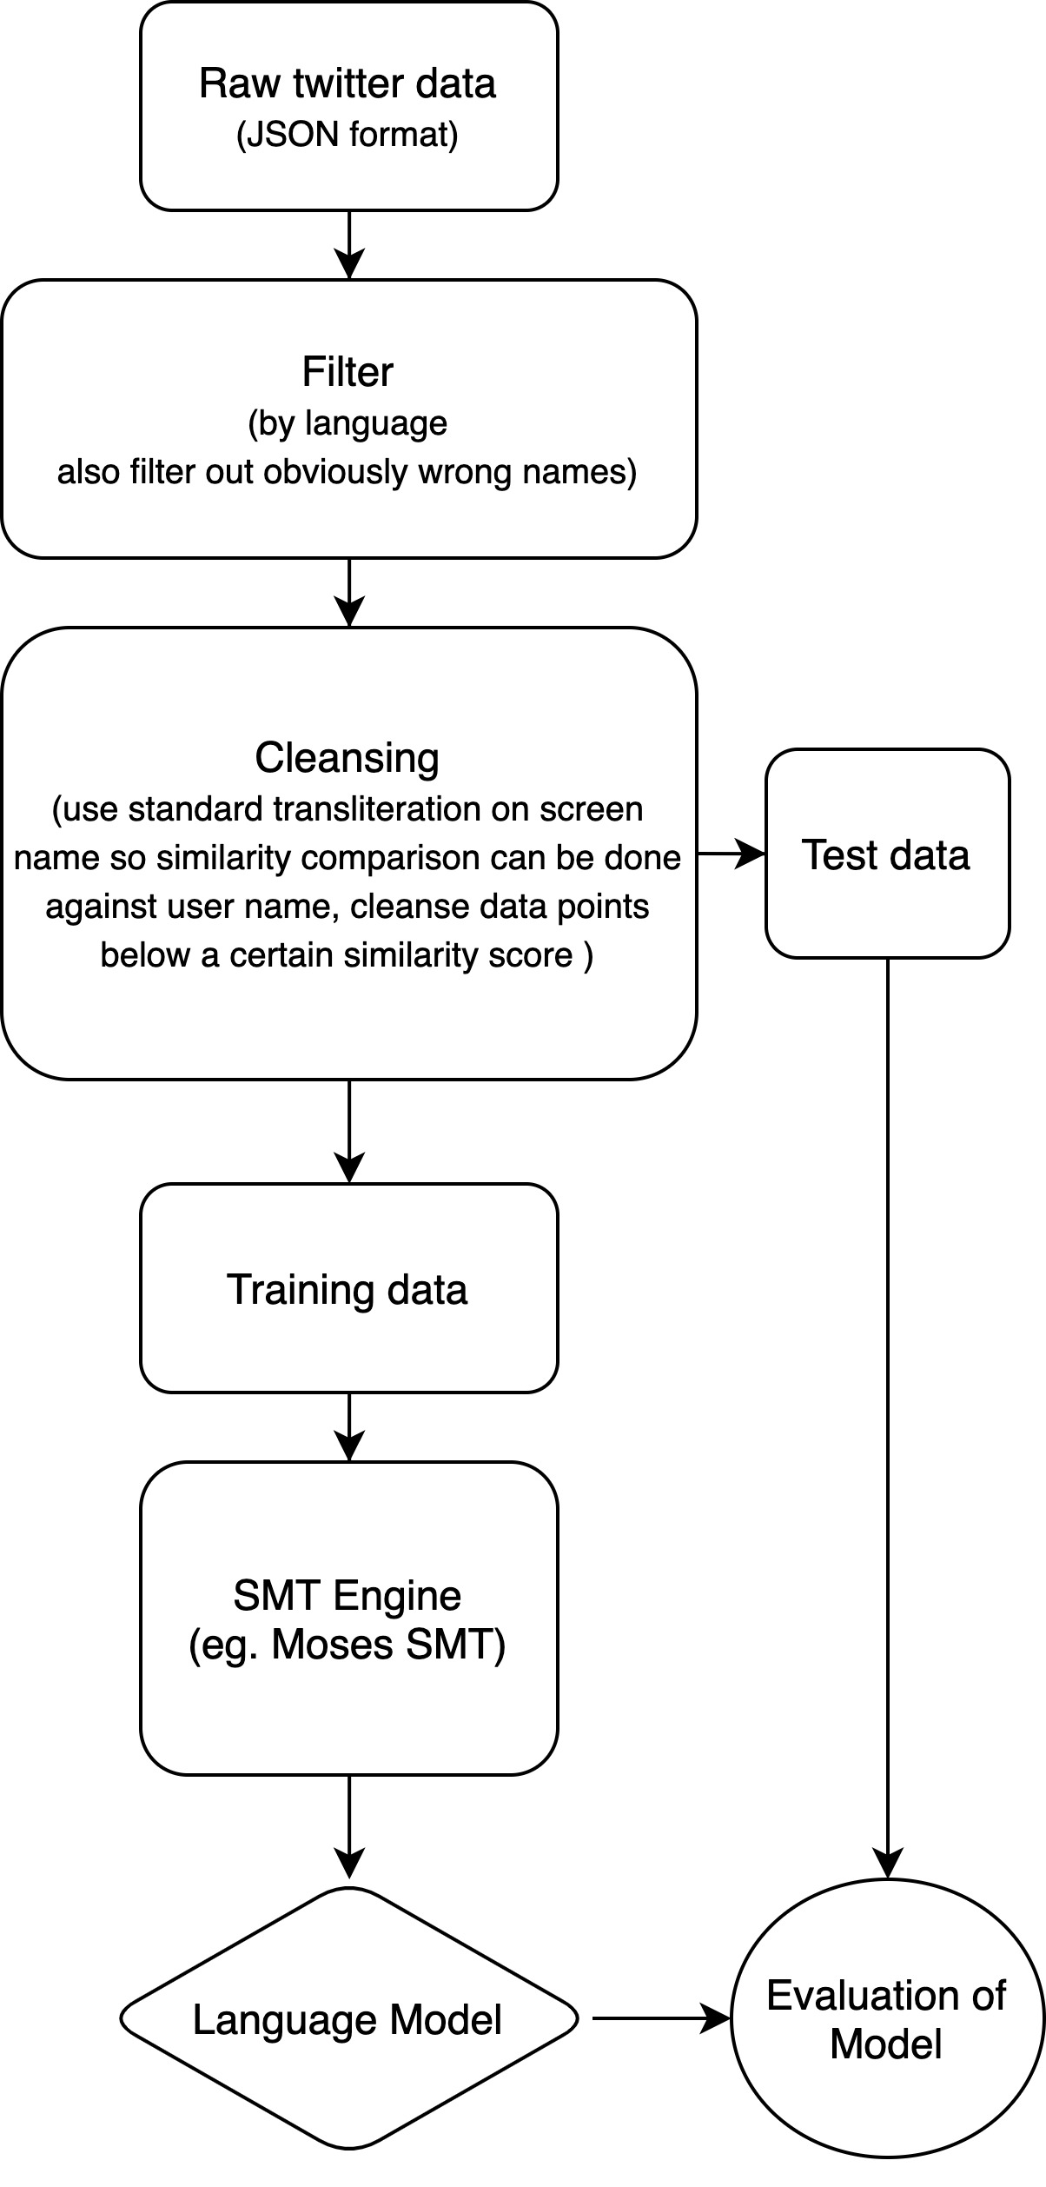
Methodology – Building the Pipeline
Split into three stages
Filtering: where the data is filtered by language
Cleansing: where a standard transliteration is applied and if the edit distance is close enough to the English name then the name pair is accepted
Training and Evaluation: where a model is trained and evaluated for effectiveness

Slide 6
Filtering
Raw Twitter tweets coming in (extracted from the Twitter public stream using API key)
Have to extract user name (English), screen name (maybe not English) and language of tweet
Tweets have a language tag and we can do a preliminary filter using that tag
Another filter is done using regex to eliminate all characters in screen name that do not belong to the language we are filtering
The data is stored as a pandas Data Frame

Slide 7
Cleansing
The purpose of the cleanser is to pick out legitimate name pairs
This is because Twitter name pairs are very noisy, users do not always enter a direct transliteration of their name
We want to pick out name pairs that have been self-transliterated by the user
The cleansing process
Use a standard transliteration system to transliterate the screen name
Compare the standard transliteration against the user name
If it is within a certain edit-distance threshold, we can assume that the name is a legitimate transliteration
What is edit-distance?
A measure of how similar two words are
How many edits does it take to transform first word into the other
Many variants are used
In this project’s case a normalised version of the edit-distance is used so that long names and short names are treated the same
Output are text files containing training and testing data

Slide 8
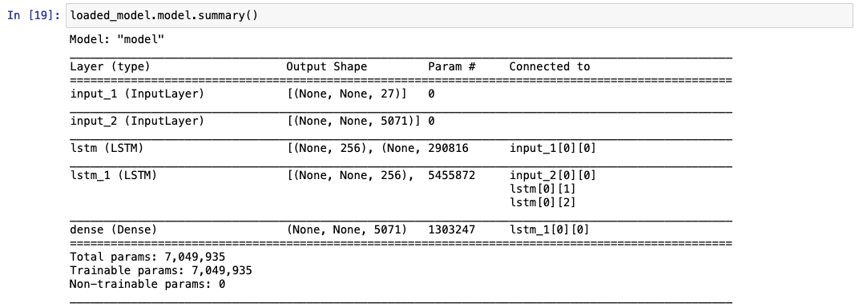
Training
Using a character-level recurrent sequence to sequence model to train data. Essentially a decoder, encoder LSTM model
The “x” is user name and the screen name
The “y” is the screen name shifted forward one time step
Given the full English name and characters of the screen name up to current time step. The model tries to predict the next character of the screen name

Slide 9
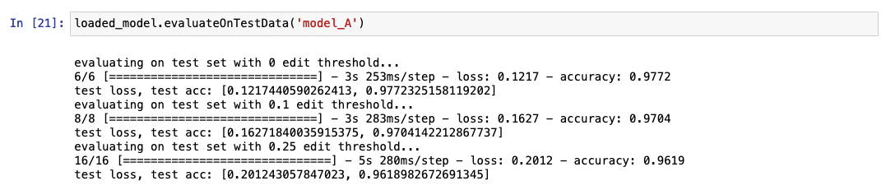
Evaluation
Since we don’t actually have gold standard self-transliterated name pairs (I do not want to pay native speakers to self-transliterate thousands of names), we instead use three different test sets which have been cleansed on different edit-distance thresholds
Test set 1: edit-distance threshold of 0
Test set 2: edit-distance threshold of 0.1
Test set 3: edit-distance threshold of 0.25

Slide 10

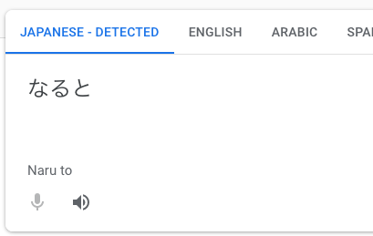
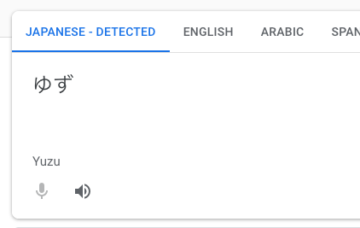
Evaluation cont.
Also did a few sanity checks by comparing against Google translate, also a Neural Machine Translation system

Slide 11
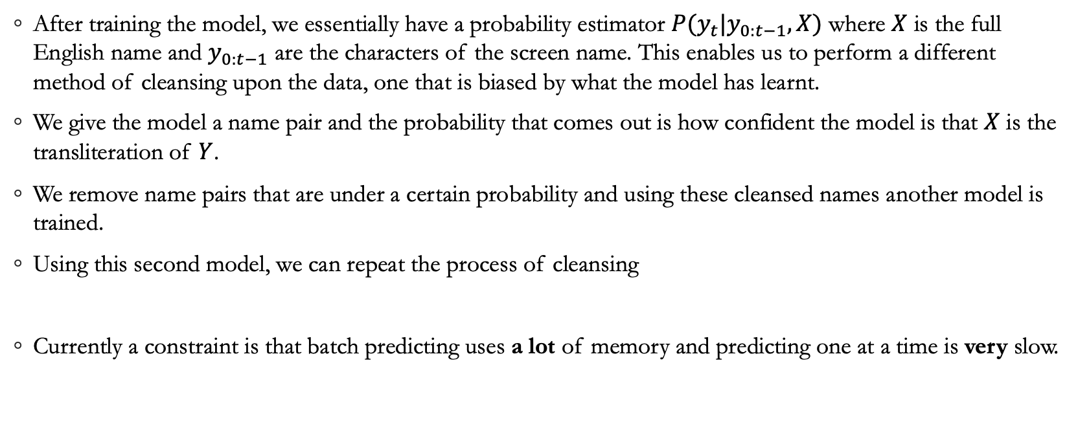
The iterative cleanser
After training the model, we essentially have a probability estimator $P(y_{t}|y_{0:t−1}, X)$ where $X$ is the full English name and $y_{0:t−1}$ are the characters of the screen name. This enables us to perform a different method of cleansing upon the data, one that is biased by what the model has learnt.
We give the model a name pair and the probability that comes out is how confident the model is that $X$ is the transliteration of $Y$.
We remove name pairs that are under a certain probability and using these cleansed names another model is trained.
Using this second model, we can repeat the process of cleansing
Currently a constraint is that batch predicting uses a lot of memory and predicting one at a time is very slow.

Slide 12
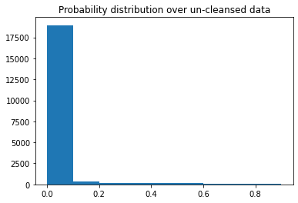
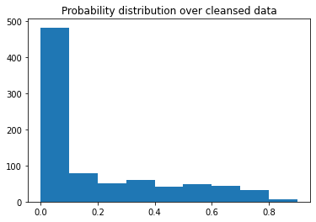
Plots

Slide 13
Results
A fully functioning pipeline
Consisting of separate python modules for each part of the pipeline
Jupyter notebooks with examples of using the created python modules to run the pipeline
Jupyter notebooks with experiments on the created pipeline

